Slide 1
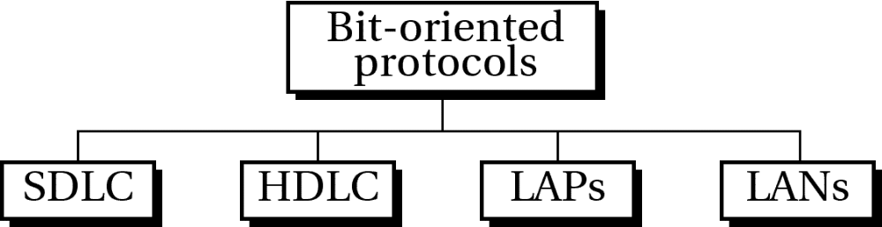
Figure 11-13
WCB/McGraw-Hill
© The McGraw-Hill Companies, Inc., 1998

Slide 2
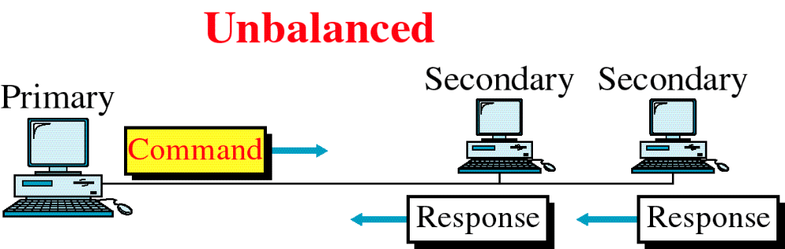
Figure 11-14
HDLC Configuration
WCB/McGraw-Hill
© The McGraw-Hill Companies, Inc., 1998

Slide 3
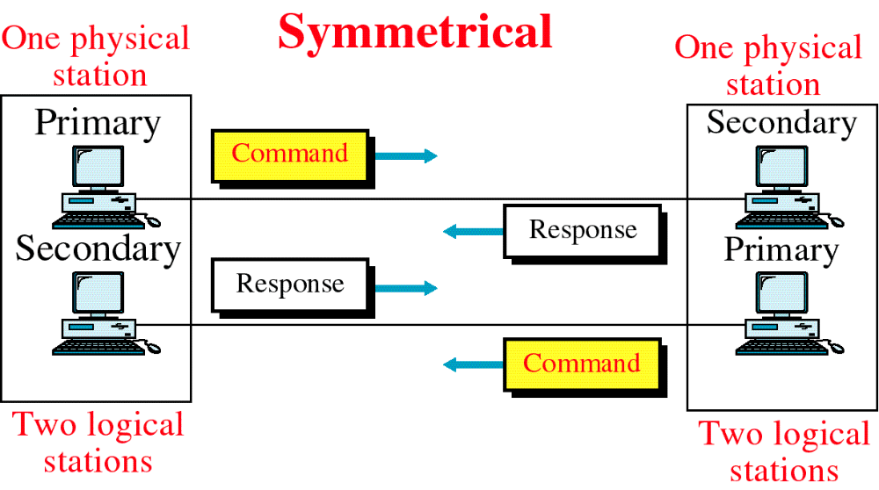
Figure 11-14-continued
HDLC Configuration
WCB/McGraw-Hill
© The McGraw-Hill Companies, Inc., 1998

Slide 4
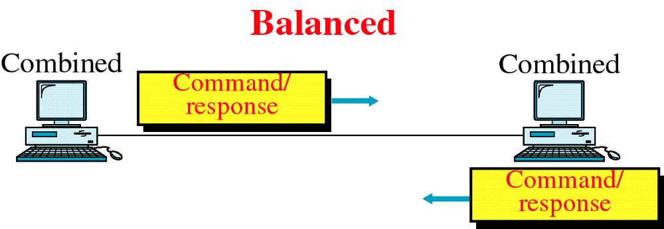
Figure 11-14-continued
HDLC Configuration
WCB/McGraw-Hill
© The McGraw-Hill Companies, Inc., 1998

Slide 5
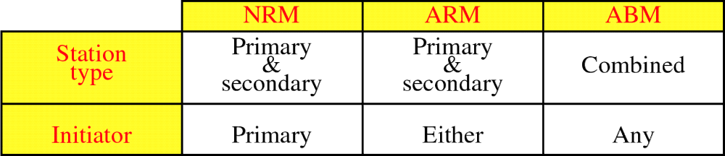
Figure 11-15
HDLC Modes
WCB/McGraw-Hill
© The McGraw-Hill Companies, Inc., 1998

Slide 6
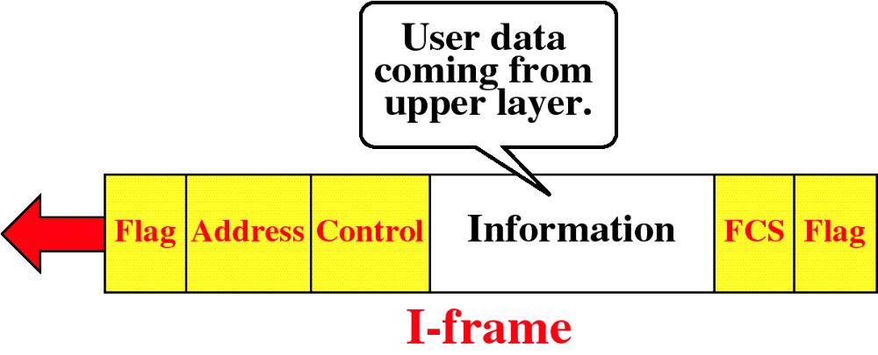
Figure 11-16
HDLC Frame Types
WCB/McGraw-Hill
© The McGraw-Hill Companies, Inc., 1998

Slide 7
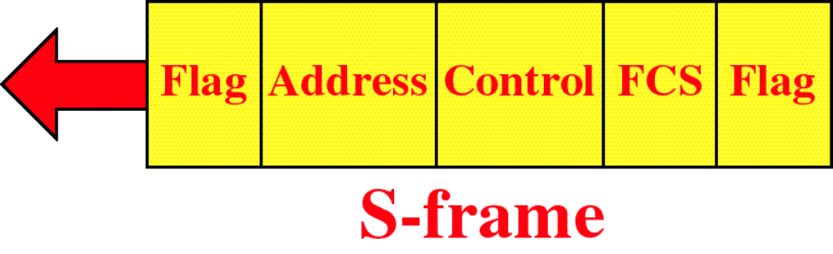
Figure 11-16-continued
HDLC Frame Types
WCB/McGraw-Hill
© The McGraw-Hill Companies, Inc., 1998

Slide 8
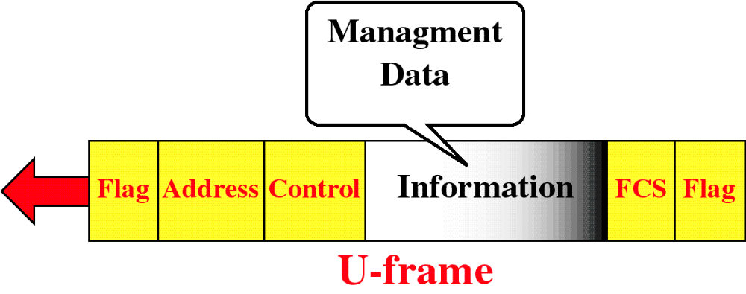
Figure 11-16-continued
HDLC Frame Types
WCB/McGraw-Hill
© The McGraw-Hill Companies, Inc., 1998

Slide 9
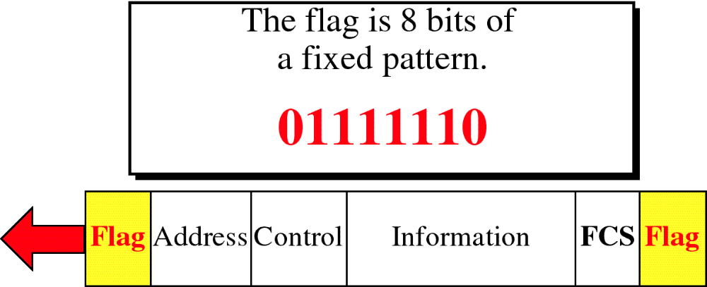
Figure 11-17
HDLC Flag Field
WCB/McGraw-Hill
© The McGraw-Hill Companies, Inc., 1998

Slide 10
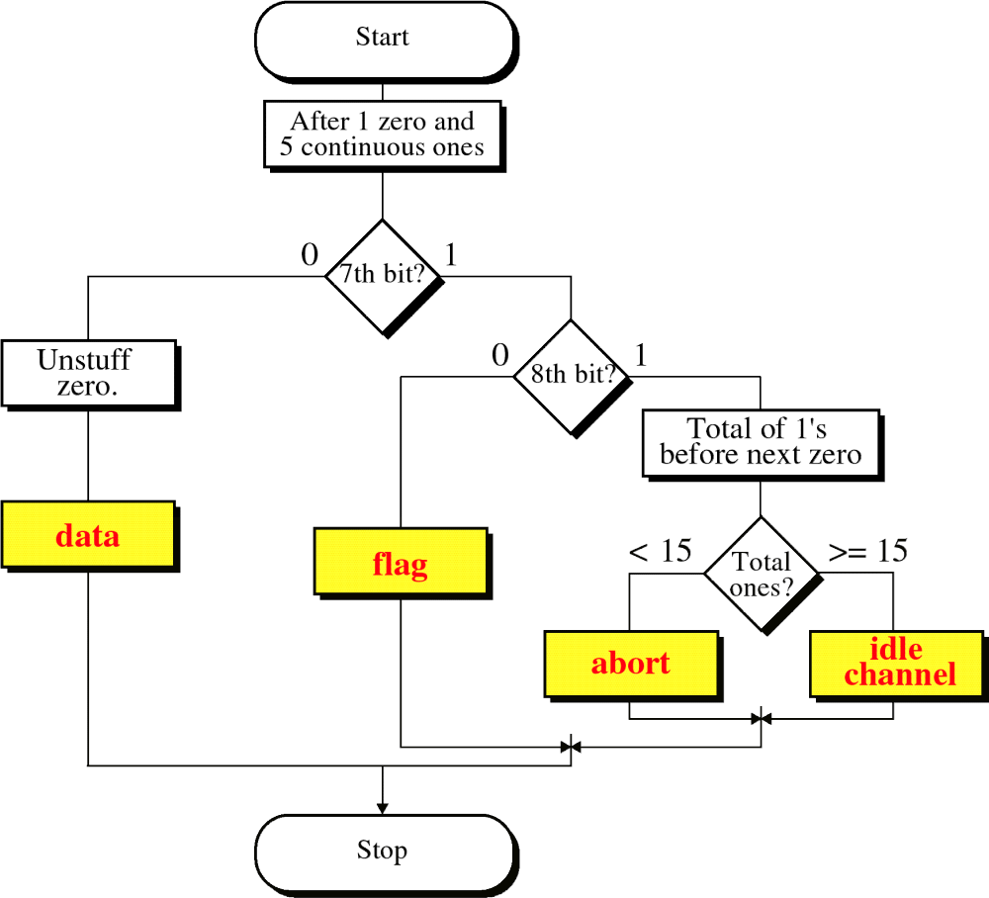
Figure 11-18
Bit Stuffing
WCB/McGraw-Hill
© The McGraw-Hill Companies, Inc., 1998

Slide 11
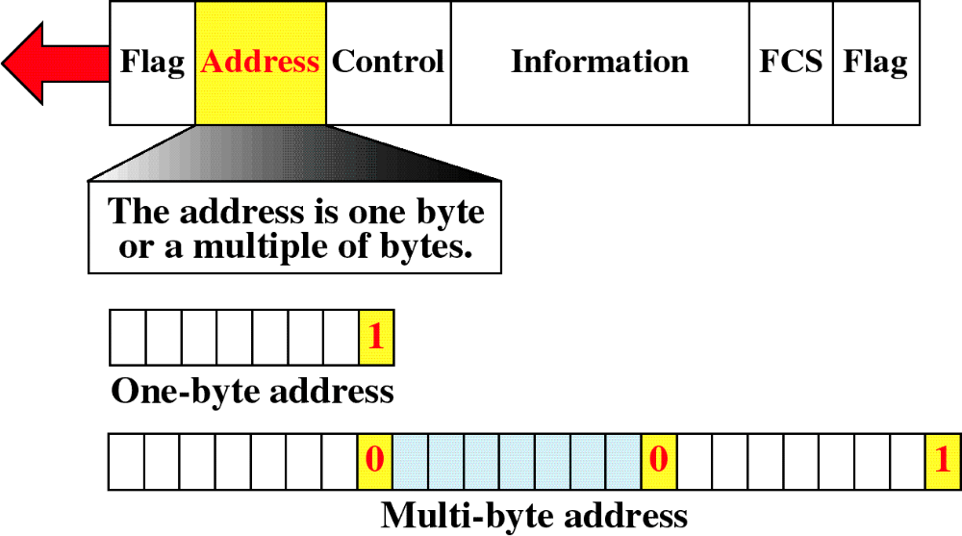
Figure 11-19
HDLC Address Field
WCB/McGraw-Hill
© The McGraw-Hill Companies, Inc., 1998

Slide 12
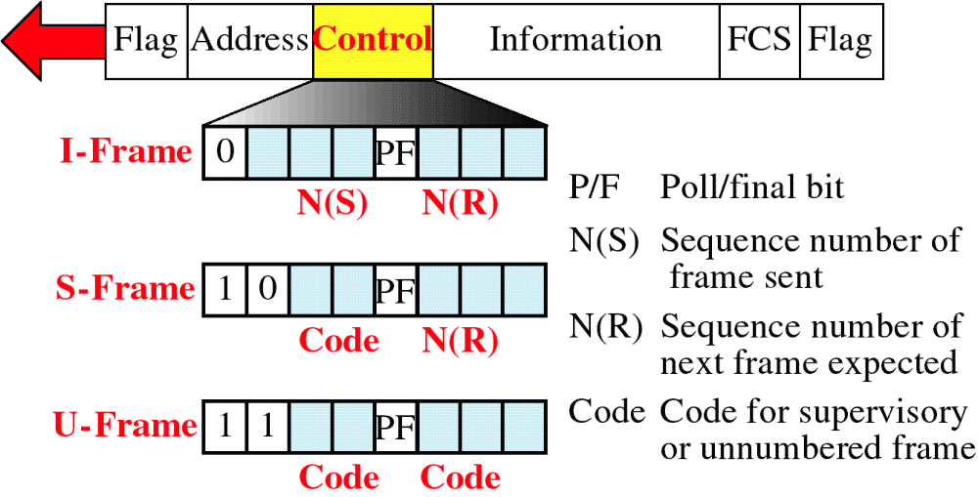
Figure 11-20
HDLC Control Field
WCB/McGraw-Hill
© The McGraw-Hill Companies, Inc., 1998

Slide 13
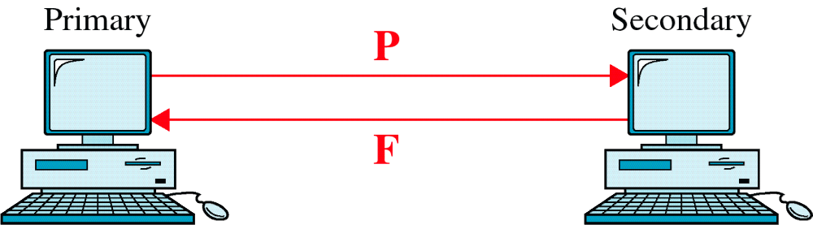
Figure 11-21
Poll/Final
WCB/McGraw-Hill
© The McGraw-Hill Companies, Inc., 1998

Slide 14
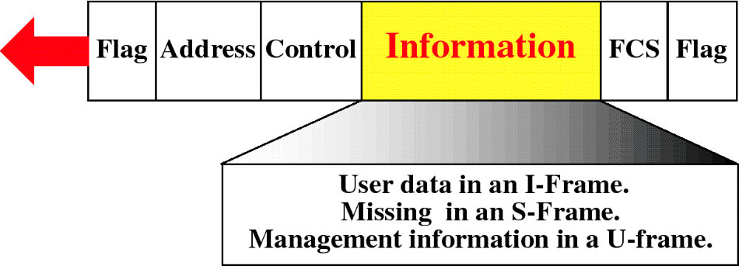
Figure 11-22
HDLC Information Field
WCB/McGraw-Hill
© The McGraw-Hill Companies, Inc., 1998

Slide 15
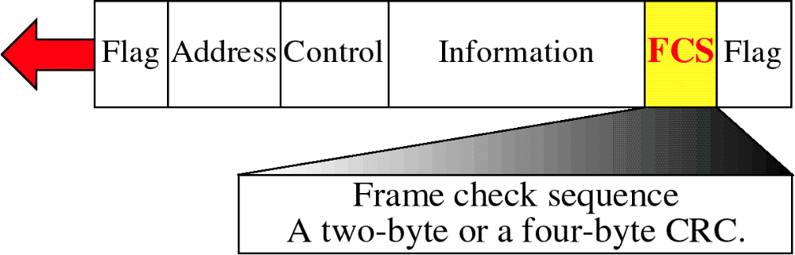
Figure 11-23
HDLC FCS Field
WCB/McGraw-Hill
© The McGraw-Hill Companies, Inc., 1998

Slide 16
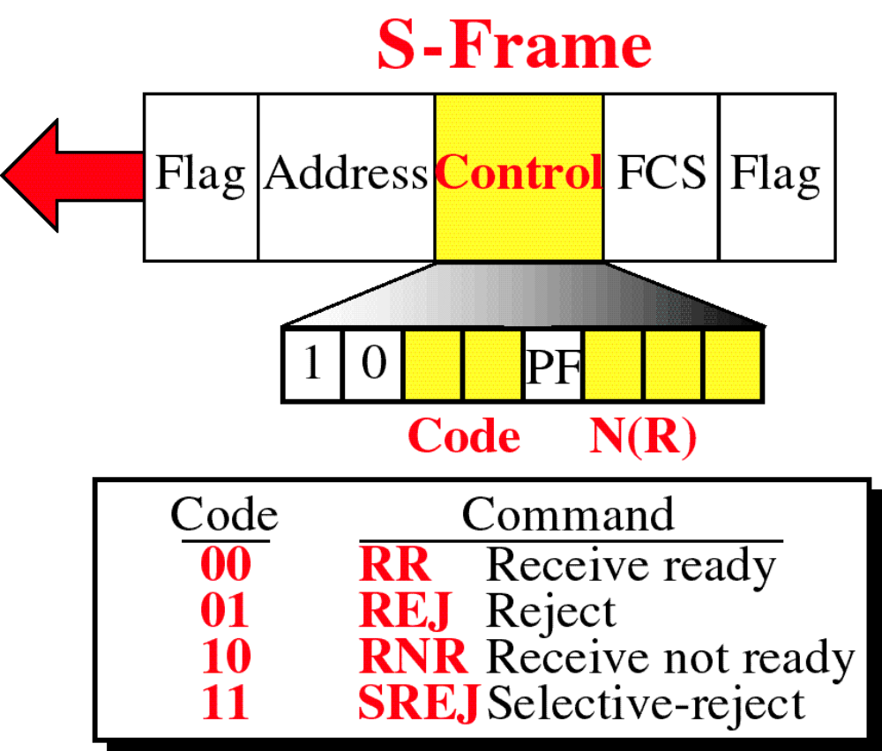
Figure 11-24
WCB/McGraw-Hill
© The McGraw-Hill Companies, Inc., 1998

Slide 17
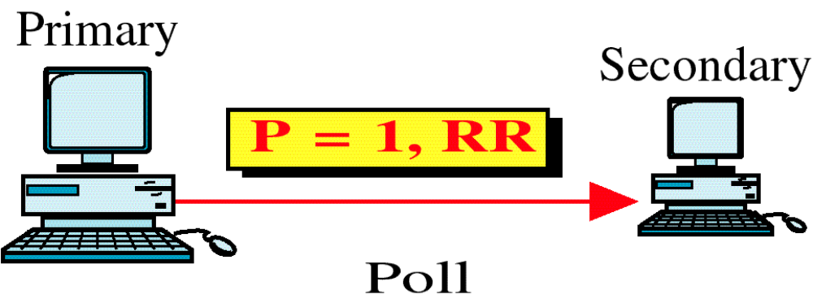
Figure 11-25
Use of P/F Field
WCB/McGraw-Hill
© The McGraw-Hill Companies, Inc., 1998

Slide 18
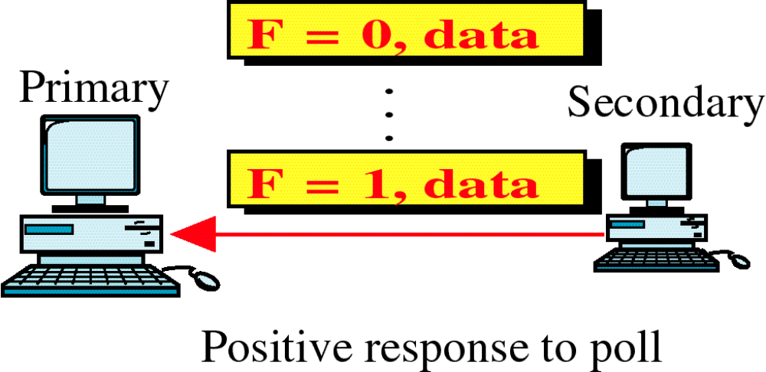
Figure 11-25-continued
Use of P/F Field
WCB/McGraw-Hill
© The McGraw-Hill Companies, Inc., 1998

Slide 19
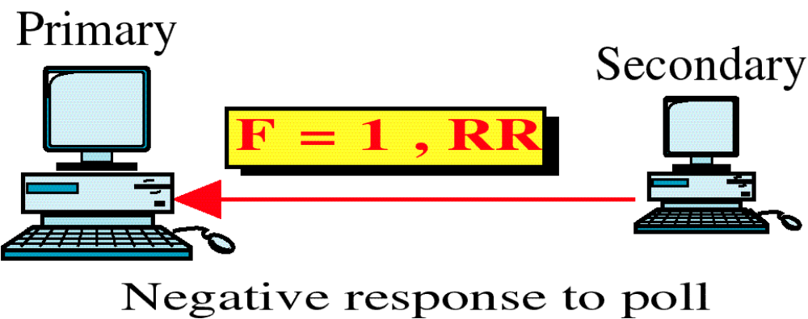
Figure 11-25-continued
Use of P/F Field
WCB/McGraw-Hill
© The McGraw-Hill Companies, Inc., 1998

Slide 20
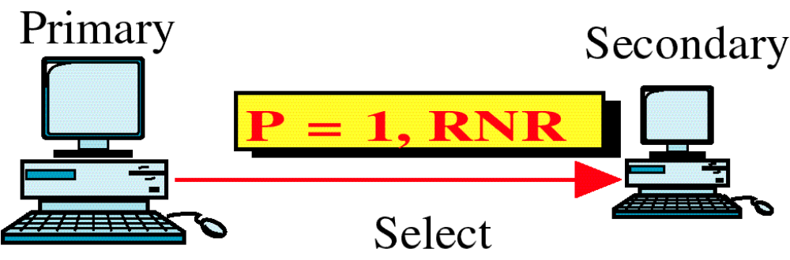
Figure 11-25-continued
Use of P/F Field
WCB/McGraw-Hill
© The McGraw-Hill Companies, Inc., 1998

Slide 21
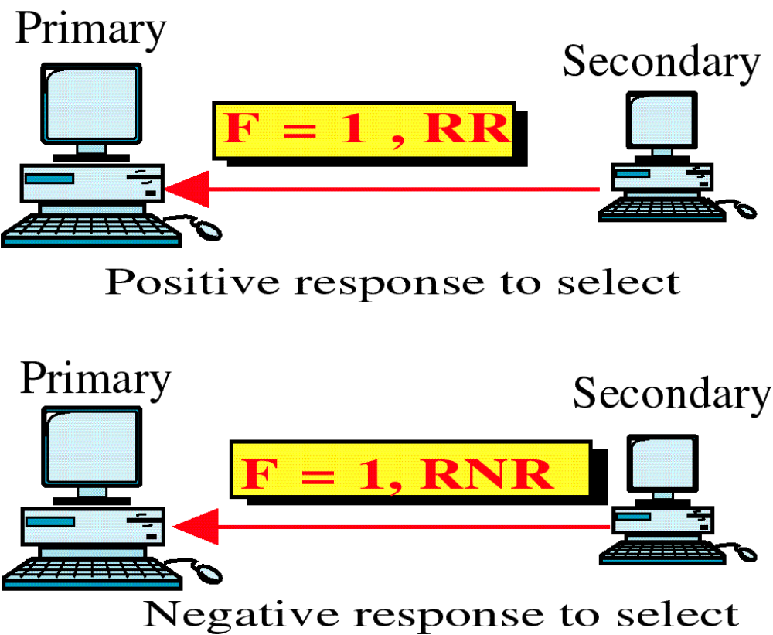
Figure 11-25-continued
Use of P/F Field
WCB/McGraw-Hill
© The McGraw-Hill Companies, Inc., 1998

Slide 22
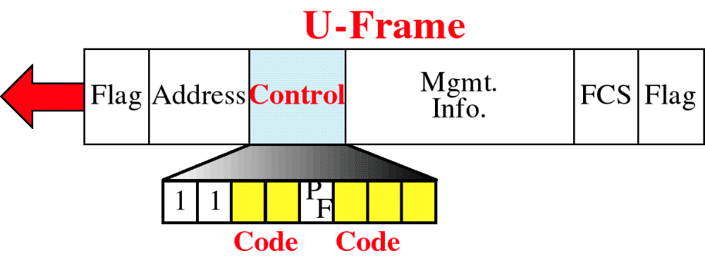
Figure 11-26
U-Frame Control Field
WCB/McGraw-Hill
© The McGraw-Hill Companies, Inc., 1998

Slide 23
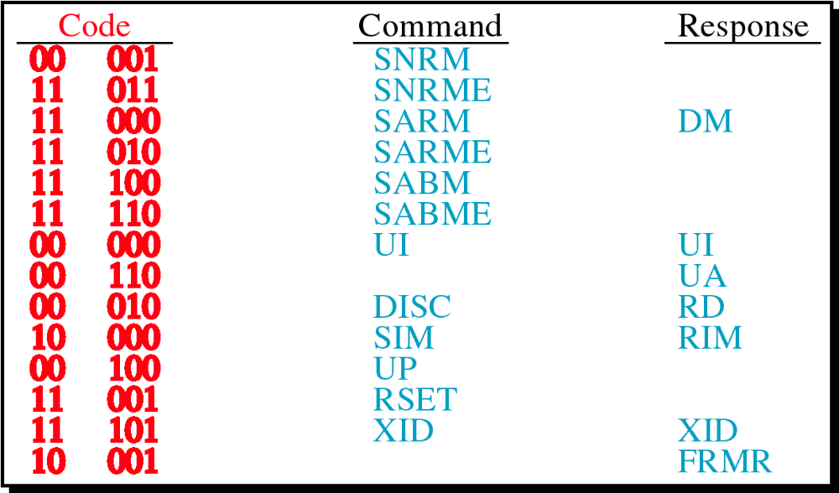
Figure 11-26-continued
U-Frame Control Field
WCB/McGraw-Hill
© The McGraw-Hill Companies, Inc., 1998

Slide 24
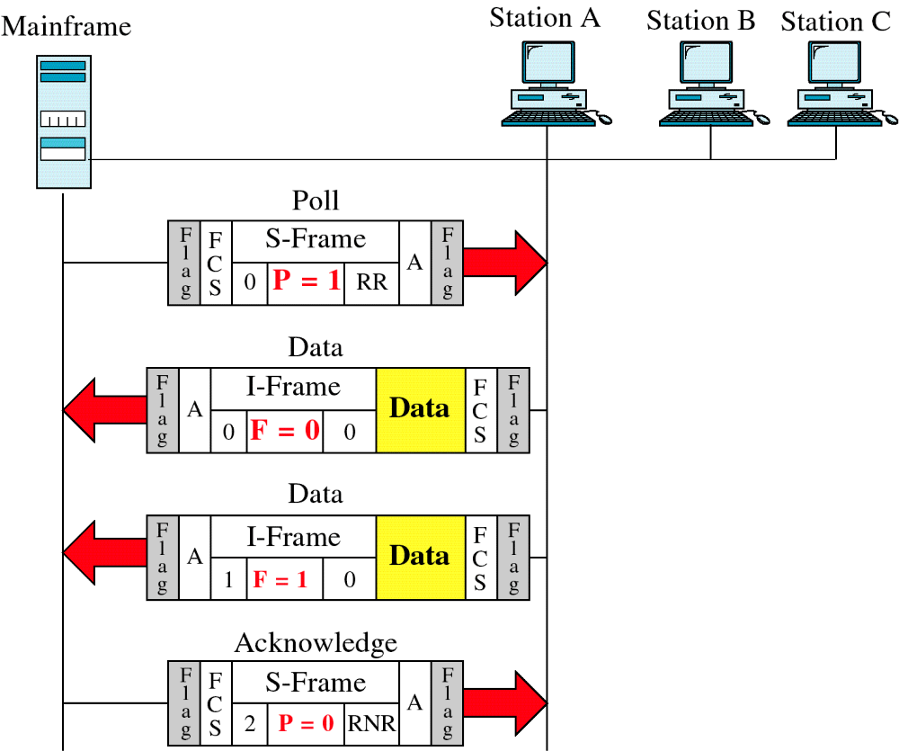
Figure 11-27
Polling Example
WCB/McGraw-Hill
© The McGraw-Hill Companies, Inc., 1998

Slide 25
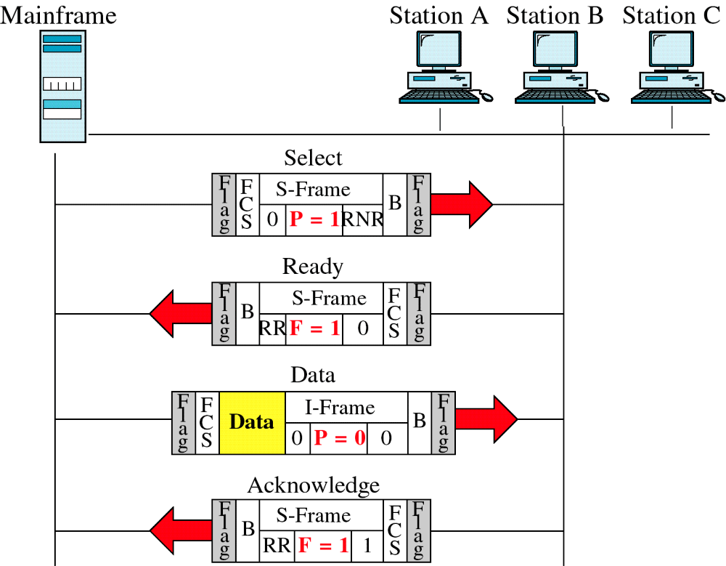
Figure 11-28
Selecting Example
WCB/McGraw-Hill
© The McGraw-Hill Companies, Inc., 1998

Slide 26
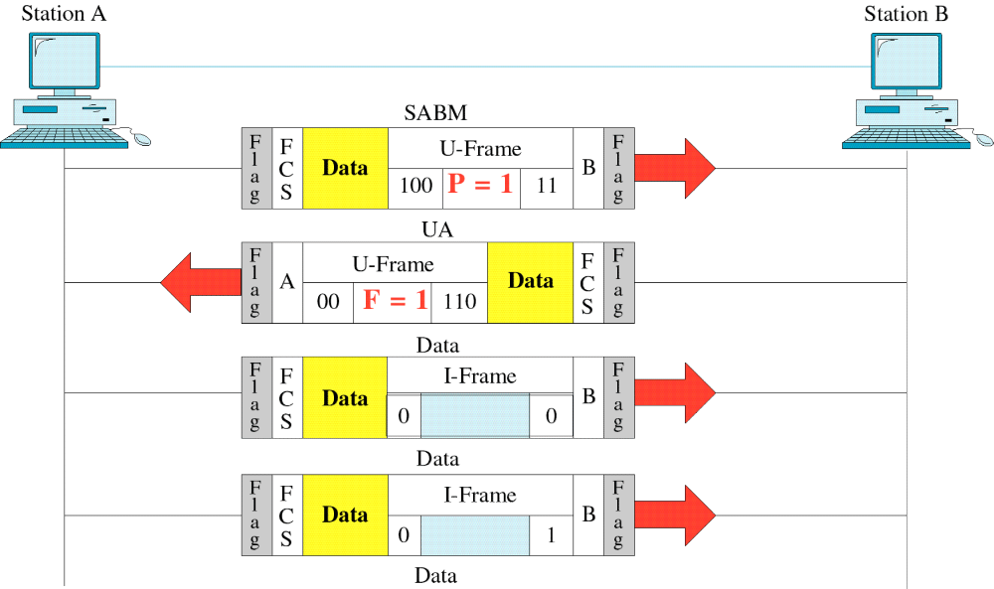
Figure 11-29
Peer-to-Peer Example
WCB/McGraw-Hill
© The McGraw-Hill Companies, Inc., 1998

Slide 27
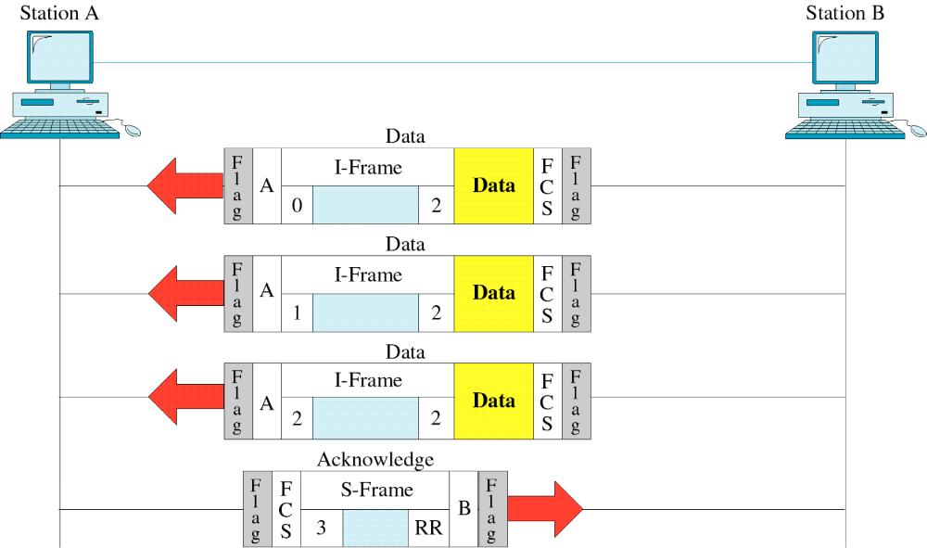
Figure 11-29-continued
Peer-to-Peer Example
WCB/McGraw-Hill
© The McGraw-Hill Companies, Inc., 1998

